Slide 1
The T.R.A.V.I.S. Project
(Television Remote and Voice Interpretation System)
Team 9:
Ann Sophie Abrahamsson, Nathan Banner,
Lillian Gwendolyn, Katy Johnson, Aidan Martens, Heath Robinson, Kanybek Tashtankulov
Notes:
Presented by: Lillian

Slide 2
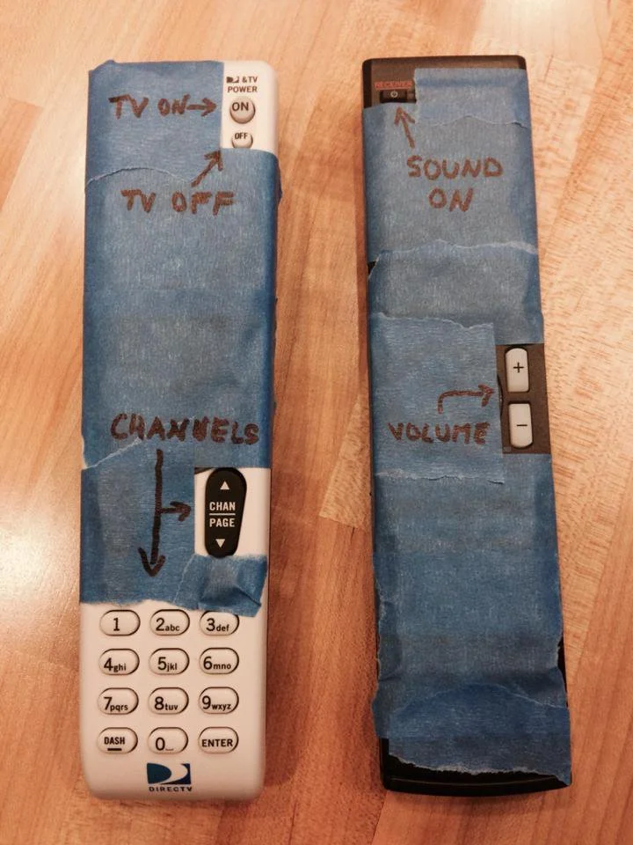
Introduction
Need: Elderly people have a hard time navigating modern entertainment devices.
Goal: Make it easier for elderly people to navigate modern entertainment devices.
Notes:
Presented by: Lillian
Image source https://www.reddit.com/r/funny/comments/1qzgfq/my_buddy_dadproofing_his_remotes/

Slide 3
Design Objectives
Design Objective | Units | Target/Range
Short setup time | minutes (alexa setup as example) | < 10
Short time needed to change channels | seconds | < 20
Inexpensive to manufacture | dollars | < 10
Device Uptime | hours | > 20
Voice Recognition Accuracy | Percentage | >60
Damage Likelihood (External) | Percentage | <10
Average Lifetime (Internal) | Years | >2
% Recyclable/Biodegradable Material | Percentage | >50
Notes:
Presented by: Ann Sophie
We have 8 categories in our design objectives:
Short and simple set up = hard for the elderly to learn new technologies
Short time needed to change channels = patience is short
Inexpensive to manufacture = want to keep it at roughly the same price point as any regular TV remote
Voice recognition accuracy = most important (since focus of project) want it to be accurate and work on a variety of voices (want to make sure it works on more mature voices)
Should be robust and have a long battery life as well as a long lifetime as it should resemble a regular TV remote
Recyclability, biodegradable material = least important, old people don’t care
HAND OFF TO NATHAN TO TALK ABOUT CONCEPTUALIZATIONS

Slide 4
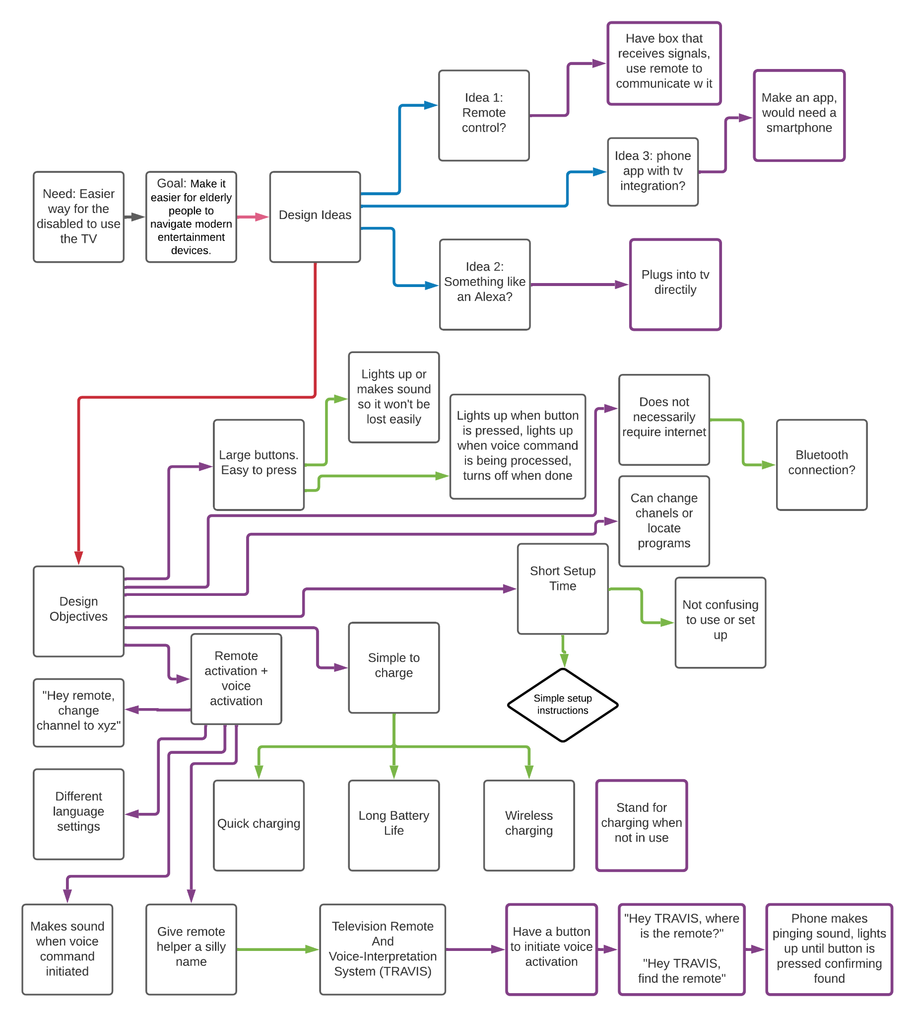
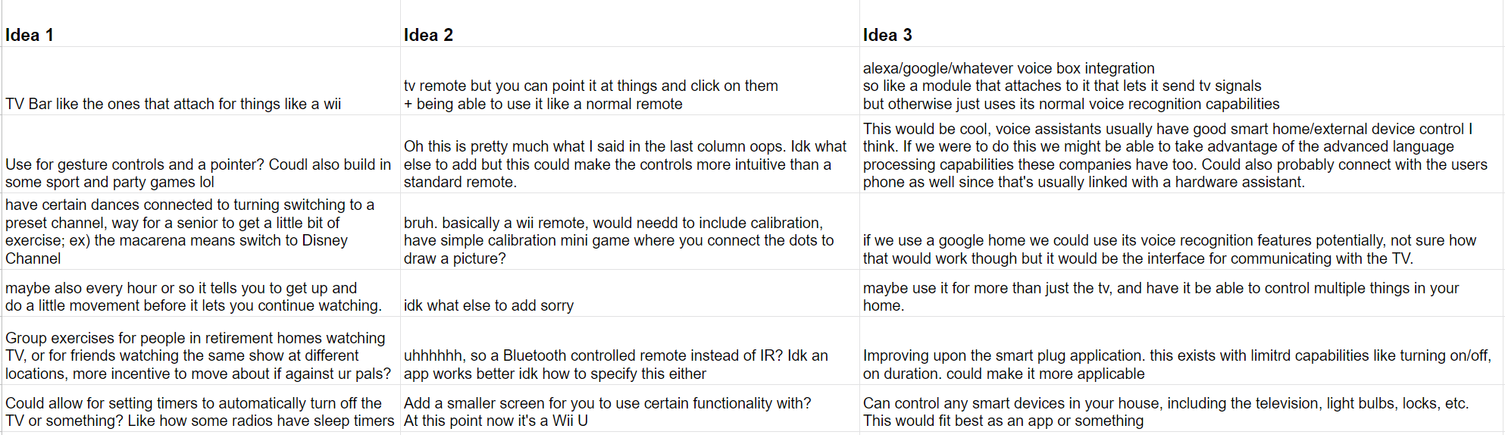
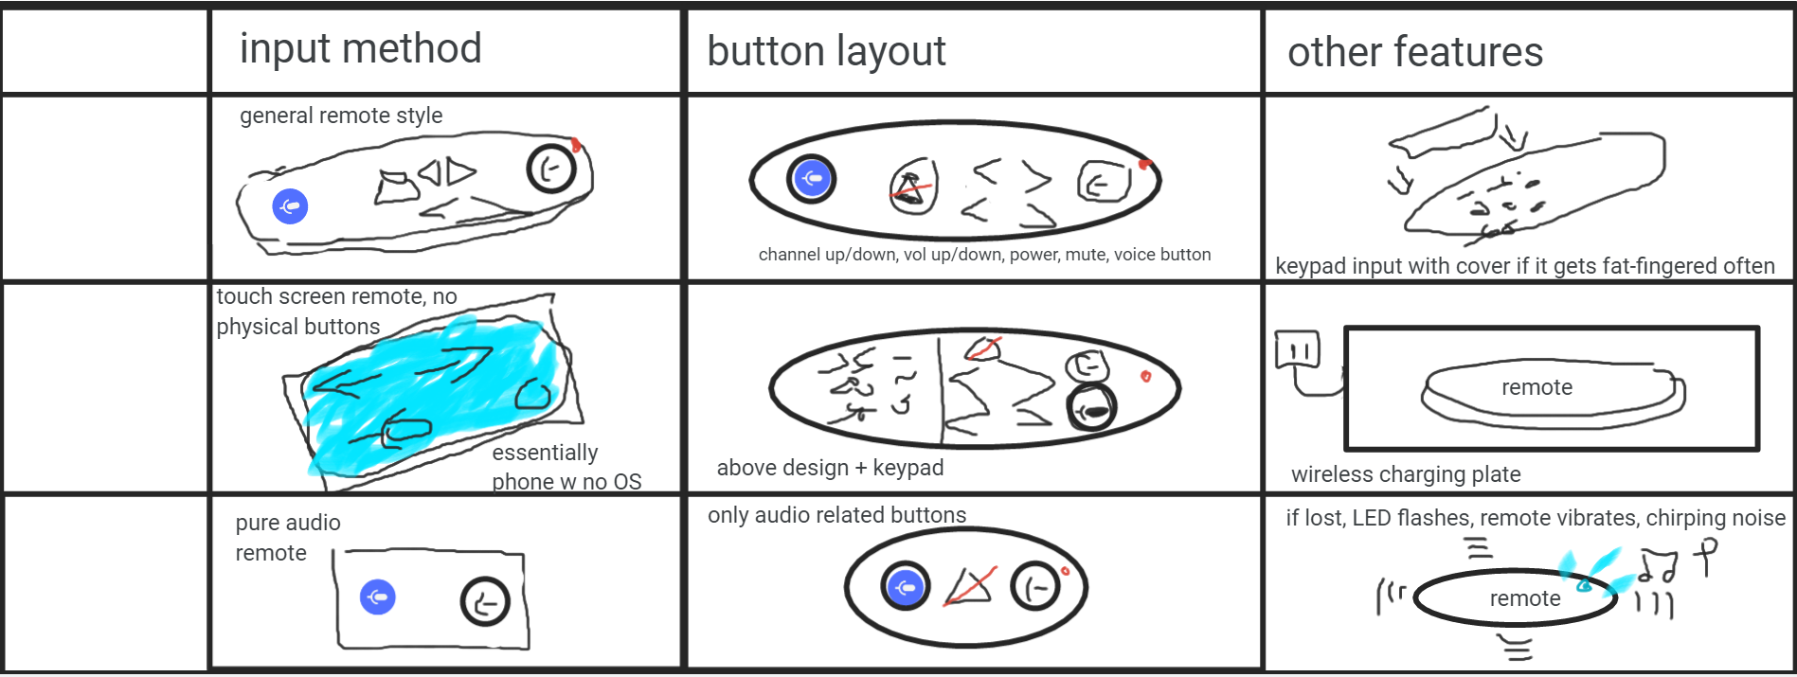
Conceptualizations
Mind Map
6-3-5 Method
Morphological Chart
Notes:
Presented by: Nathan
First formulated group: came up with pill dispenser and auto-closet and self-lacing corsets. Had logistical issues. Branched out and idea for an easier way to use television if elderly or disabled arose. Remote control, TV box, phone app.
Had a lot of ideas going into it. Mind map helped us organize our ideas into where they most fit. Show the bottom square with TRAVIS. Settled with remote since we had the most ideas for it.
Morphological chart was useful to compare our ideas to existing ones, analyzing the immediate pros and cons and setting the base for our final design approach. Could mention briefly specific ideas that became part of final design.

Slide 5
Options Considered
Criteria | Weight | Design 1: Remote |  | Design 2: TV Box |  | Design 3: App
 |  | Raw | Weighted | Raw | Weighted | Raw | Weighted
Cost | 10 | 4 | 40 | 2 | 20 | 5 | 50
Device Uptime | 10 | 4 | 40 | 5 | 50 | 2 | 20
Task Startup Time | 15 | 1 | 15 | 4 | 60 | 3 | 45
Voice Recognition Accuracy | 25 | 2 | 50 | 2 | 50 | 2 | 50
Damage Likelihood (External) | 5 | 3 | 15 | 4 | 20 | 5 | 25
Average Lifetime (Internal) | 10 | 5 | 50 | 2 | 20 | 5 | 50
Recyclability | 5 | 5 | 25 | 1 | 5 | 5 | 25
Setup Time | 15 | 5 | 75 | 5 | 75 | 5 | 75
Manufacturing Cost | 5 | 4 | 20 | 2 | 10 | 5 | 25
Total
Notes:
Presented by: Katy
Transition: After decided on design options, placed in design table to determine which design would be best
Decision Table:
Estimated criteria values based on info found online
weighting decided based on the criteria we thought were most important
voice recognition accuracy priority
Transition: The app won!

Slide 6
Options Considered
Criteria | Weight | Design 1: Remote |  | Design 2: TV Box |  | Design 3: App
 |  | Raw | Weighted | Raw | Weighted | Raw | Weighted
Cost | 10 | 4 | 40 | 2 | 20 | 5 | 50
Device Uptime | 10 | 4 | 40 | 5 | 50 | 2 | 20
Task Startup Time | 15 | 1 | 15 | 4 | 60 | 3 | 45
Voice Recognition Accuracy | 25 | 2 | 50 | 2 | 50 | 2 | 50
Damage Likelihood (External) | 5 | 3 | 15 | 4 | 20 | 5 | 25
Average Lifetime (Internal) | 10 | 5 | 50 | 2 | 20 | 5 | 50
Recyclability | 5 | 5 | 25 | 1 | 5 | 5 | 25
Setup Time | 15 | 5 | 75 | 5 | 75 | 5 | 75
Manufacturing Cost | 5 | 4 | 20 | 2 | 10 | 5 | 25
Total | 100 | 33 | 330 | 27 | 310 | 37 | 365
Notes:
Presented by: Katy
App won, has highest total, cause: cost (app is free), app will always have higher point value than other two, bit unfair

Slide 7
Options Considered
Criteria | Weight | Design 1: Remote |  | Design 2: TV Box |  | Design 3: App
 |  | Raw | Weighted | Raw | Weighted | Raw | Weighted
Cost | 10 | 4 | 40 | 2 | 20 | 5 | 50
Device Uptime | 10 | 4 | 40 | 5 | 50 | 2 | 20
Task Startup Time | 15 | 1 | 15 | 4 | 60 | 3 | 45
Voice Recognition Accuracy | 25 | 2 | 50 | 2 | 50 | 2 | 50
Damage Likelihood (External) | 5 | 3 | 15 | 4 | 20 | 5 | 25
Average Lifetime (Internal) | 10 | 5 | 50 | 2 | 20 | 5 | 50
Recyclability | 5 | 5 | 25 | 1 | 5 | 5 | 25
Setup Time | 15 | 5 | 75 | 5 | 75 | 5 | 75
Manufacturing Cost | 5 | 4 | 20 | 2 | 10 | 5 | 25
Total | 100 | 33 | 330 | 27 | 310 | 37 | 365
Notes:
Presented by: Katy
Ultimately chose remote design even though has lower value
better for our target client base(elderly)
easier to use than smaho becuz of physical buttons
Intuitive, design people are familiar w/
some elderly people don’t have smartphones
PASS OFF TO HEATH

Slide 8
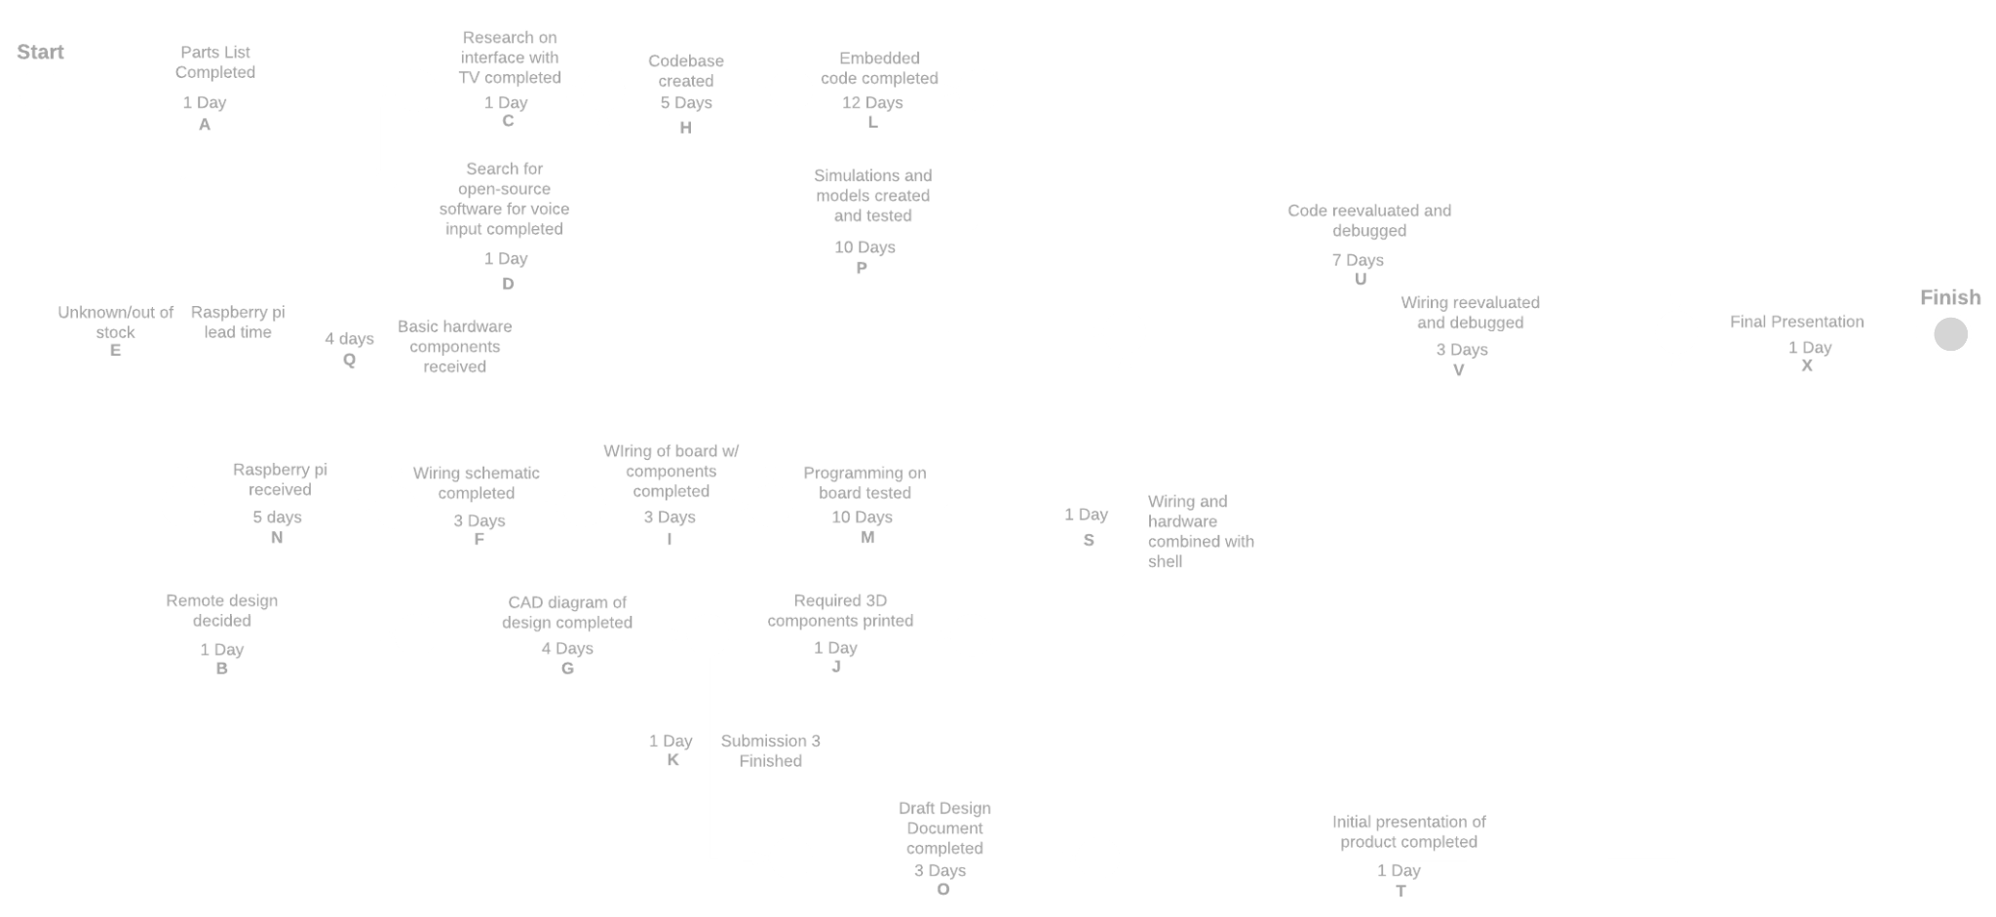
Planning: CPM
Notes:
Presented by: Heath
A few different paths we have to get through to reach our goal.
Top row of nodes is software and research.
Center row is the electronics, which depends on some steps of our software development especially for testing how both parts work together.
Lower center row is CAD and physical design, which is relatively separate from our other paths but converges before reevaluations.
Bottom row is presentation and submission material
Most paths converge before testing, and then they all converge before final presentation after testing.
Our longest path is predicted to be in the software section, since our functionality is mostly software based (figuring out the right signals to send to TV, interpreting voice, accessing internet for TV schedules)

Slide 9
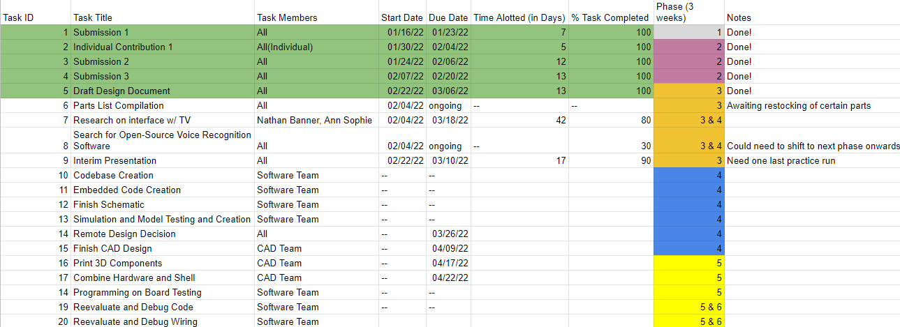
Planning: Gantt Chart
Notes:
Presented by: Heath
Gantt chart has been helpful along with CPM to visualize deadlines and crucial tasks
Time allotted good to identify workload and priority in order to prevent major blockers in pipeline
Decided to keep it in a simple cascading style of a spreadsheet, easier to follow.
Division of phases is to help break down progress to ensure tasks are done in batches, helps group and deduce relevant tasks
Pending tasks will be divided amongst members, small team

Slide 10
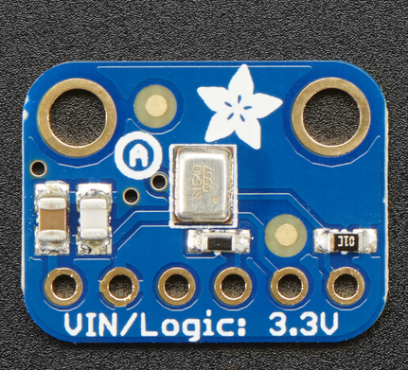
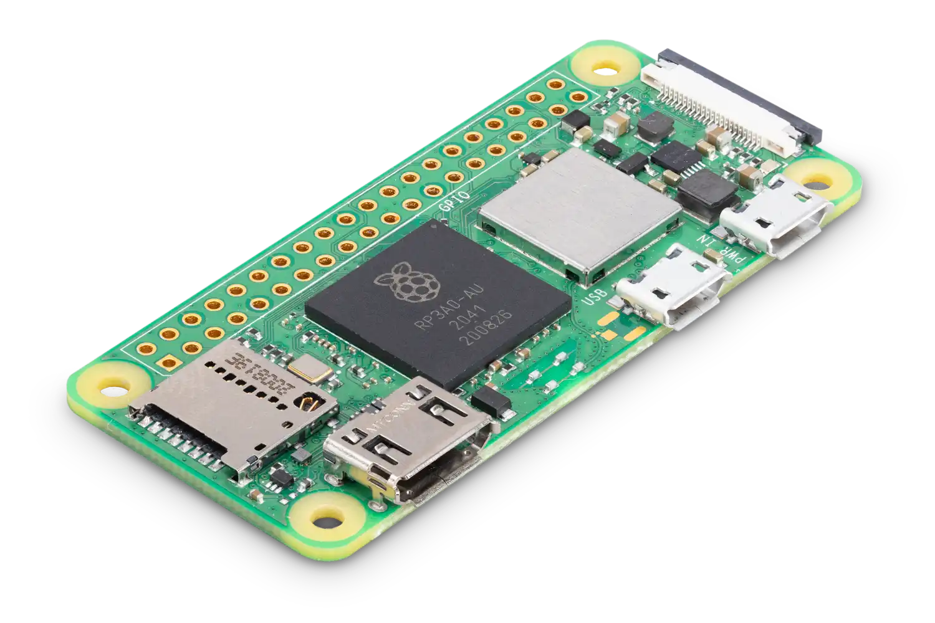
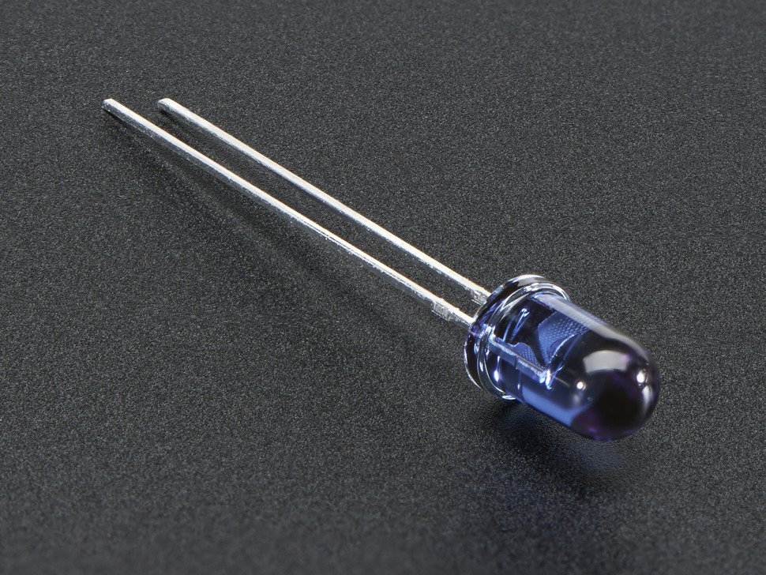
Parts & Hardware P1
Adafruit I2S MEMS Microphone Breakout - SPH0645LM4H
Raspberry Pi Zero 2 W Microcontroller
Power Consumption: Recommended 5V/2.5A
Possible To Lower
Super-bright 5mm IR LED - 940nm IR Transmitter
Notes:
Presented by: Kenny
Using rberry pi: Small form factor is great, all will be done in house
5V supply is limit
Standard IR transmitter for compatibility in mind
Adafruit microphone: Good small form factor, suitable for testing, might need upgrades to improve detection range of voice
Power info from: https://www.cnx-software.com/2021/12/09/raspberry-pi-zero-2-w-power-consumption/
Pics included from sites linked in our parts list: https://docs.google.com/spreadsheets/d/1saEoC_vuIEPTorTc-8mn2Pe2RrpY6fYExBaYzlkzTE8/edit#gid=0

Slide 11
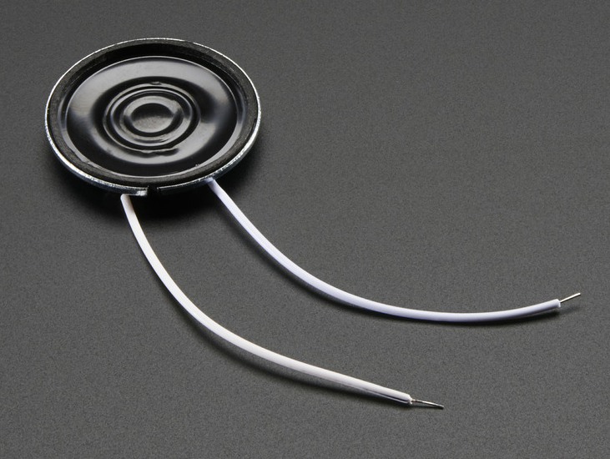
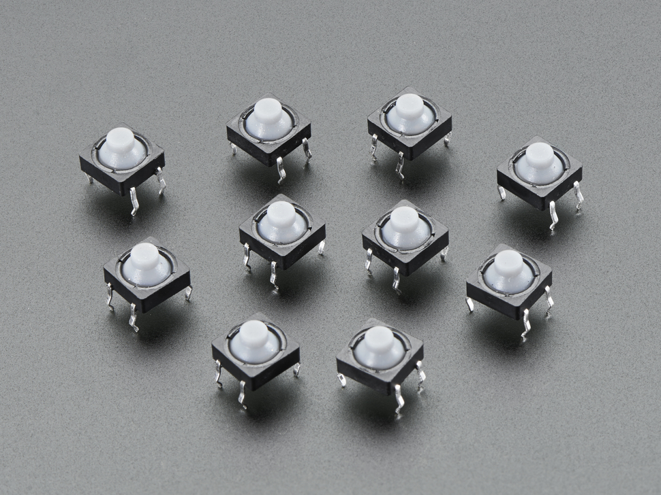
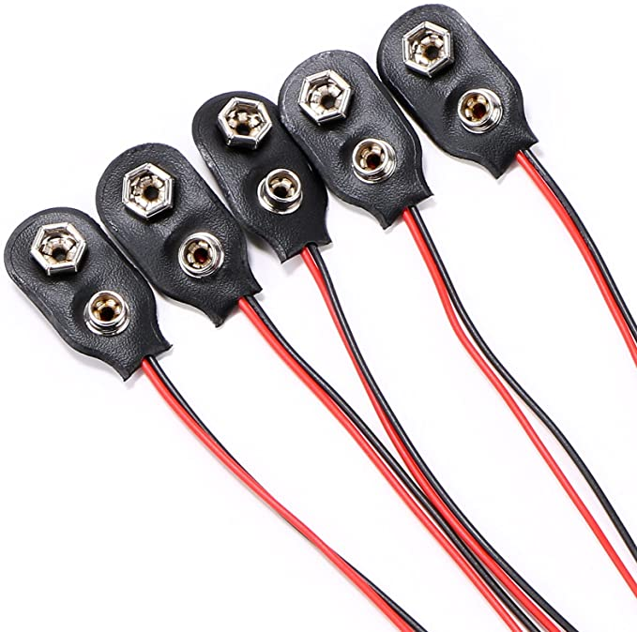
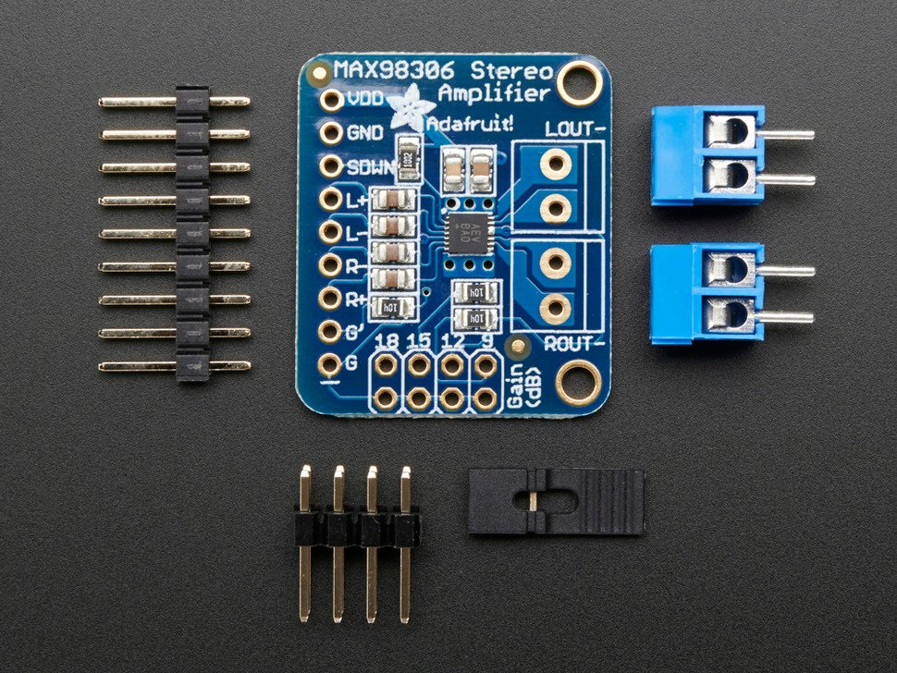
Parts & Hardware P2
Mini Metal Speaker w/ Wires - 8 ohm P < 0.5W
Soft Tactile Button (8mm)
Yoodelife 9V Battery Clip Connector, 9 Volt Long Cable Connection Soft Shell I Type, Black
Power Input 9V Battery Eco-Friendly Additions TBD Current Cost: ~$35
Stereo 3.7W Class D Audio Amplifier - MAX98306
Notes:
Presented by: Kenny
Simple button setup, will 3d print own covers for buttons
Speaker to relay responses to voice input and to help locate lost device
Audio amplifier for speaker to increase volume output, outputs 1.7W with our speaker, considerations when driving speaker as it could blow it out at full power
Power input is currently rechargeable batteries for testing, could implement wireless charging model if within time frame
Not much on eco-friendly end, thinking of using biodegradable filament for printing
Pics included from sites linked in our parts list: https://docs.google.com/spreadsheets/d/1saEoC_vuIEPTorTc-8mn2Pe2RrpY6fYExBaYzlkzTE8/edit#gid=0

Slide 12
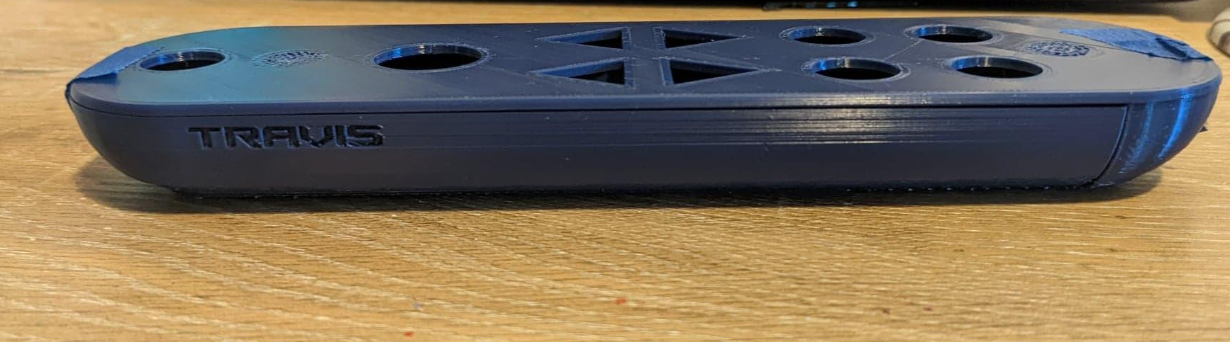
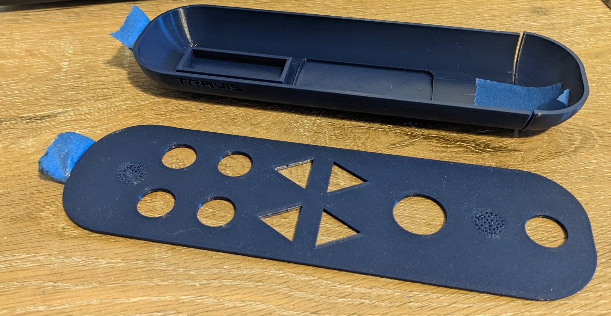
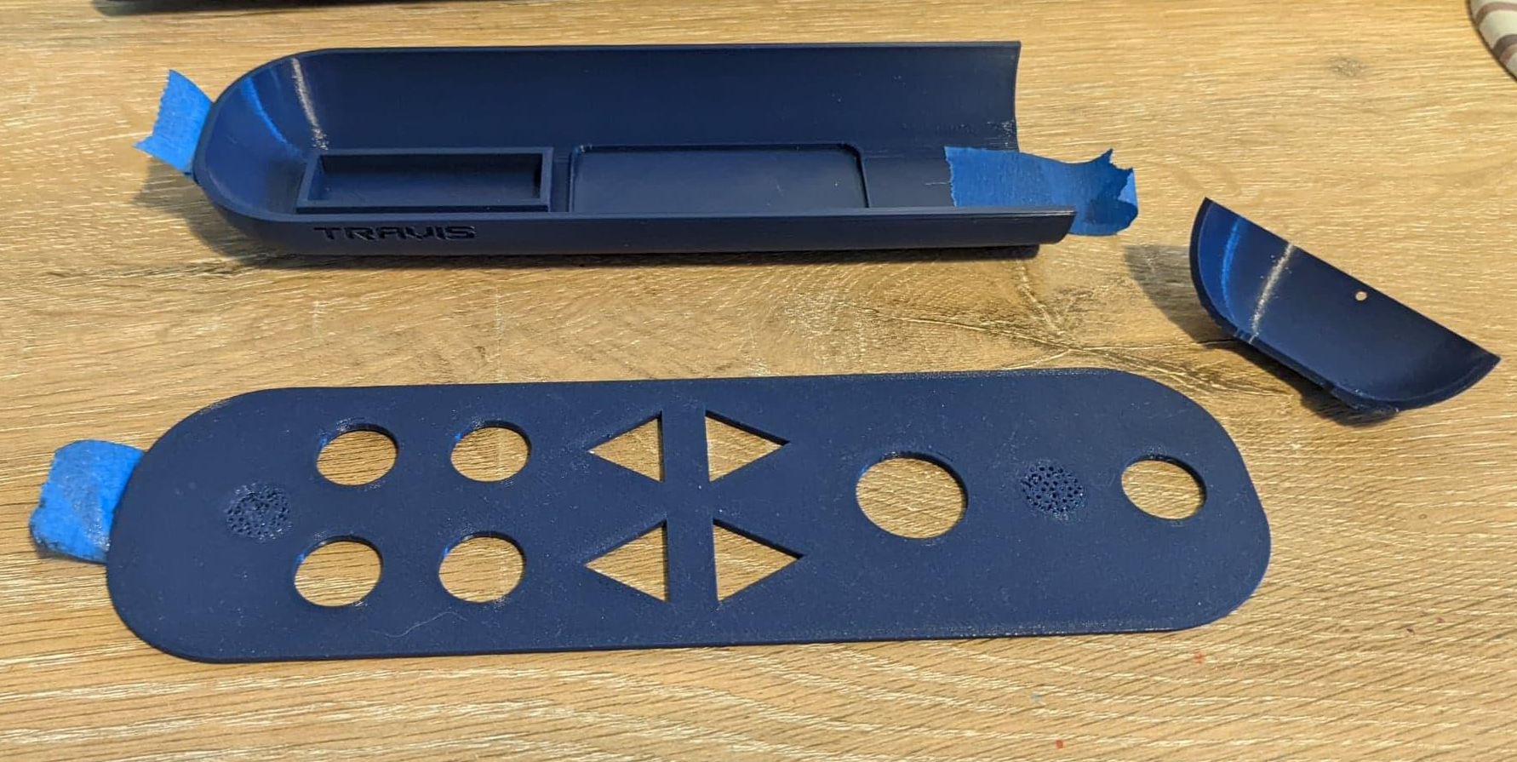
Prototype
Notes:
Presented by: Aidan
Front piece is the tiny part - separate because it is meant to be see-through for the IR transmitter to go through.
Back is where the battery pack is, meant to have a back door where you can put batteries into it.
Lmao this slide kinda ugly

Slide 13
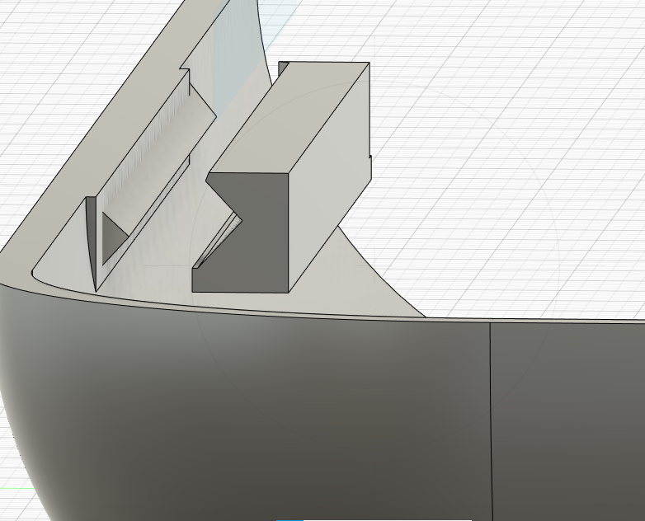
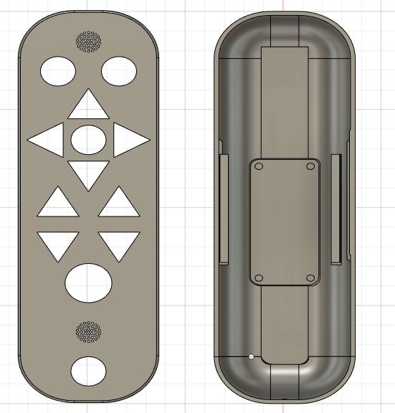
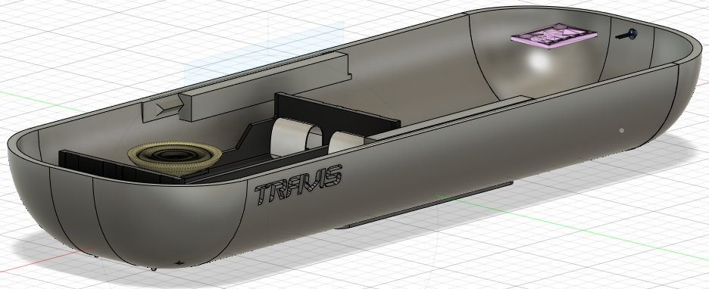
CAD
Notes:
Presented by: Aidan TV On/Off
Remote Voice Input Activated/Deactivated
Cursor Up, Down, Left, and Right
Select
Channel Up and Channel Down
Volume Up and Volume Down
Source
Mute
IR transmitter at front

Slide 14
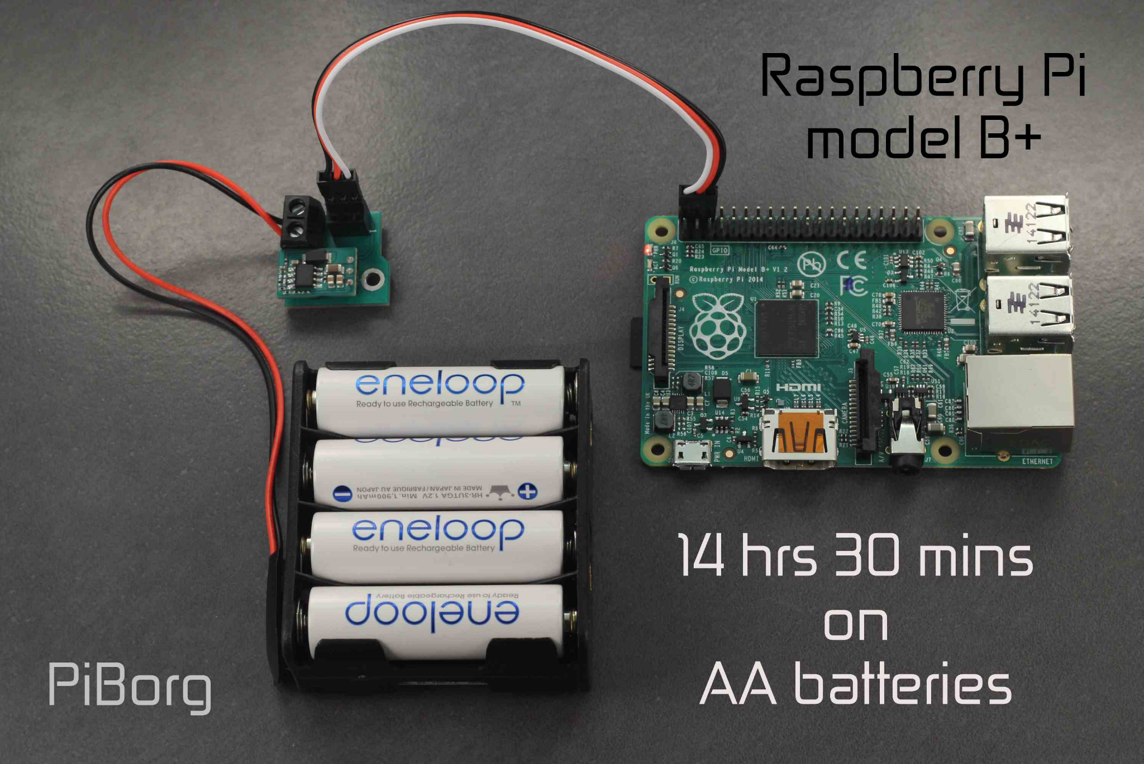
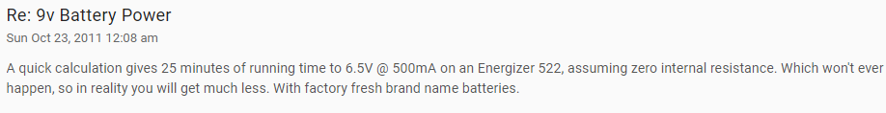
Outstanding Issues
Specific Raspberry Pi model backordered :(
Battery life is CONCERNING!!
Sustainability is expensive!
Biodegradable 3d printing filament not cheap, maybe better in bulk
Rechargeable battery setup would double cost
Notes:
Presented by: Lillian
Bottom pic from https://forums.raspberrypi.com/viewtopic.php?t=15050
Right pic from https://www.piborg.org/blog/battborg-overview-getting-started Power info from https://www.cnx-software.com/2021/12/09/raspberry-pi-zero-2-w-power-consumption/ and https://www.arrow.com/en/research-and-events/articles/battery-power-your-pi

Slide 15
Looking Ahead
Research already done-
TV IR communication is easy
Voice-activated capability is the big question
Current status-
Programming to begin over spring break
CAD already on its way, hard to gauge progress
Wiring seems quick w/ RP GPIO
Ideal demo-
Completed shell, wiring, voice interface
Buttons, batteries, internals not the main focus
Notes:
Presented by: Lillian
Pics from prev slides

Slide 16
Questions?

